Slide 1
Interviews
Doing Political Research

Slide 2

What is an Interview?
Purposeful conversation with participants
Dyadic interaction, with clearly defined roles: interviewer/interviewee
Usually between strangers - formal
‘Inter’ – ‘view’ suggests an exchange of views between two people, but usually quite one-sided

Slide 3

Types of Research Interview
Structured
Semi-structured
Unstructured/informal
Specific sub-types, for example:
Life history
Oral history
Focus groups (later this term)
Elites: specific issues that will be covered later in term

Slide 4
Who Will You Interview?

Slide 5
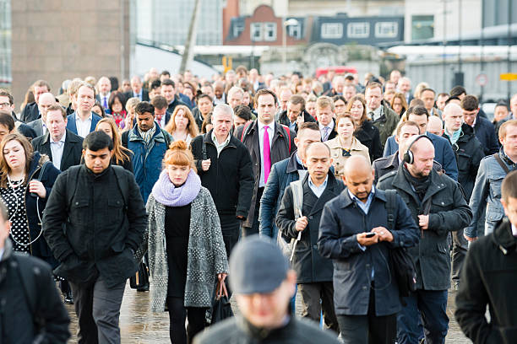
Who Will You Interview?
Who do you want to interview?
What is the target population?
How can you get access to them?
How representative a sample can you obtain?
How much does representativeness matter?

Slide 6
Finding Interviewees
Personal networks
Direct contact
Advertising
Use of intermediaries (organisations or individuals)
Research companies
Snowball sampling
Purposive sampling
But who isn’t interviewed? Could this skew your results?

Slide 7
Who Interviews?

Slide 8
Who Interviews?
What characteristics can be identified about the interviewer(s)?
How might these characteristics influence interviewees’ responses?
What might be assumed about the intentions of the interviewer?
Positionality of the interviewer

Slide 9
Interviewer Effects
Social desirability, stereotype threat, desire to please
Early research on (survey) interviewer effects focused on race in the USA
Black respondents were more likely to say they would vote to a co-racial interviewer
Black respondents got fewer answers correct in factual questions about politics when interviewed by white interviewers
White respondents gave more liberal, less racist answers when interviewed by black interviewers
Other interviewer effects: gender, age, religiosity, who is running the study
Practical issues: use of interpreter or intermediary
How to minimise?
Multiple interviewers
Clear statement of research goals at the beginning
Present as neutrally as possible

Slide 10
Where Will the Interviews Take Place?

Slide 11
Where Will the Interviews Take Place?
Will the interviews be in person, by phone/Zoom or by email?
If in person, where will they take place? In interviewees’ homes or workplaces, a café, on the street, a meeting room?
How might the format and/or physical location affect the interview?

Slide 12
Interview Formats/Location
Often depends on practical issues and types of population you are interviewing
Aim should be to make the interviewees comfortable
Be aware of how the format/location could affect the interview
Could a variety of formats be useful? Pilot your interview design

Slide 13
How Will You Conduct the Interview?

Slide 14
How Will You Conduct the Interview?
How structured will you make the interview?
What specific questions will you ask?
Will you ask follow-up questions?
How will you respond to interviewers who are evasive, go off-topic, repeatedly change their mind?
Will you use vignettes or hypotheticals?
How will you record the interview?
How might all of these choices affect interviewers’ responses?

Slide 15
Conducting Interviews
There is a lot of advice in textbooks, articles etc
Two key issues: preparation and flexibility
Pilot studies can be useful to refine your approach
Remember, all of your decisions can affect the content of the interview

Slide 16
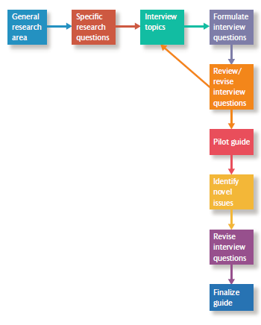
Preparing an Interview Guide (Bryman’s Social Research Methods)
Create a certain amount of order in terms of the topic area
Formulate interview questions or topics in a way that will help you answer your research questions
Use language that will be comprehensible and relevant
Avoid leading questions
Ask for relevant contextual information

Slide 17
How Will You Analyse the Data?

Slide 18



Analysing Interview Data
What data have you collected?
Recordings
Transcripts
Notes (during, after)
Thematic analysis: finding patterns in the data
Inductive
Deductive
Computer software can help with organising and coding data eg NVivo, MaxQDA, Atlas.ti

Slide 19

Ontology and Epistemology (Mosley)
Positivists
Use interviews to test hypotheses and establish causal relationships between social phenomena
Interviewer effects should be minimised and/or controlled for
Data should be replicable
Interpretivists
Use interviews to explore participant’s understand of social phenomena
Sensitive to the ‘double hermeneutic’: replicability more difficult to achieve
Interviews as a process not a product
Positionality and power relationships are central
But dividing lines are not always strict

Slide 20
Conclusion
Many issues to consider in designing interview research: interviewees, interviewers, mode/location of interview, type/style of interview, deductive or inductive coding of data
These choices will affect the answers you receive
Preparation, flexibility and piloting are key

